Slide 1
Introduction to Database Design
Week 05.

Slide 2
Objectives
Describe the concept of Entity-Relationship model;
Describe the roles of Primary Key and Foreign Key in Entity Relationship;
Demonstrate how to create Entity Relationship Diagram.

Slide 3
Tools Required
MySQL DB
MySQL Workbench

Slide 4
Introduction TO Entity-Relationship Model

Slide 5
Entity-Relationship Model
Entity-Relationship (ER) Model is based on the notion of real-world entities and relationships among them.
While formulating real-world scenario into the database model, the ER Model creates entity set, relationship set, general attributes and constraints.
ER Model is best used for the conceptual design of a database.

Slide 6
Entity
An entity can be a real-world object, either animate or inanimate, that can be easily identifiable.
For example, in a school database, students, teachers, classes, and courses offered can be considered as entities.
All these entities have some attributes or properties that give them their identity.

Slide 7
Attributes
Entities are represented by means of their properties, called attributes.
All attributes have values. For example, a student entity may have name, class, and age as attributes.
The domain of an attribute defines the range of values that can be assigned to the attribute.
For example, a student's name cannot be a numeric value. It has to be alphabetic. A student's age cannot be negative, etc.

Slide 8
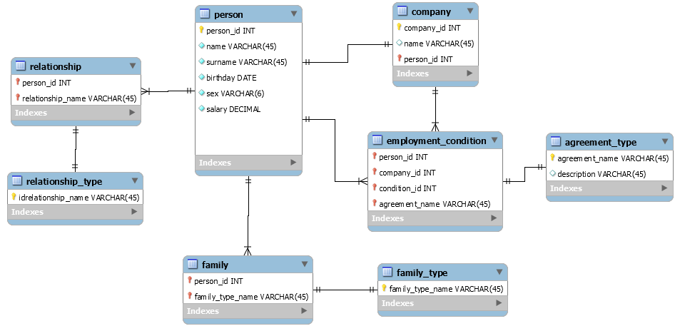
Example of ER Diagram

Slide 9
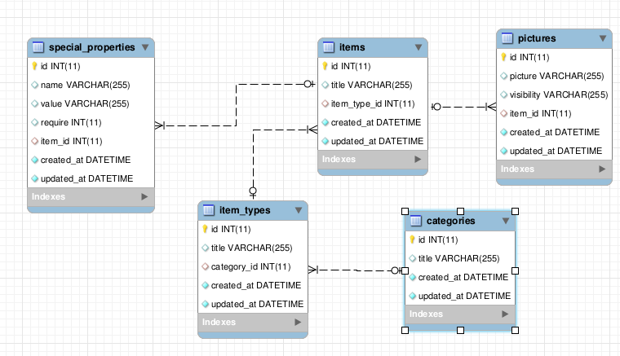
Example of ER Diagram

Slide 10
Designing Database For Movie Review Website

Slide 11
Identify the Tables
The Movie Review website consists of the following two tables:
Movie |  |  | Remark
_id | INT |  | PK, NN, AI
title | VARCHAR(255) |  | NN
availability | VARCHAR(15) |  | NN
story | TEXT(1024)
buy | TEXT(1024)
thumb | VARCHAR(255) |  | NN
video1 | VARCHAR(255)
video2 | VARCHAR(255)
poster | VARCHAR(255) |  | NN
advice | VARCHAR(255)
cast | TEXT(1024)
director | VARCHAR(60)
genre | VARCHAR(50)
duration | VARCHAR(20)
release | VARCHAR(30)
Comment |  | Remark
_id | INT | PK, NN, AI
movieId | INT | FK, NN
movie | VARCHAR(255) | NN
username | VARCHAR(20) | NN
review | TEXT(1024)
datePosted | VARCHAR(100)
rating | INT
The movieId attribute is also a Foreign Key (FK) and is linked to the Primary Key of the movie table.
The field names in both tables are taken from the attributes that we retrieved using the APIs. Because the JavaScript codes used the attribute names, it is better to use them in the tables so that no modifications of the codes are required.
The data type of each field are selected based on observing the value of each attribute.

Slide 12
Schema Design
You will now learn how to design the schema of the Movie Review website using Entity-Relationship Model, and then use MySQL Workbench to create the schema automatically.
Move to the next slide to start a new Model in MySQL Workbench.
You can watch the demo here

Slide 13
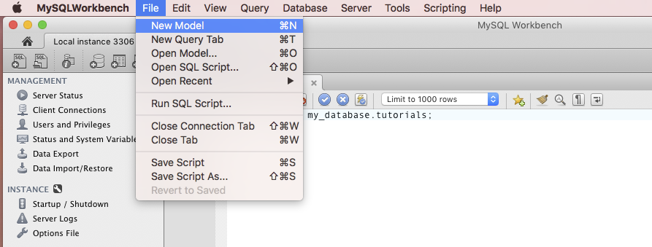
Creating a New Model
In MySQL Workbench, go to File menu and select New Model as shown here.

Slide 14
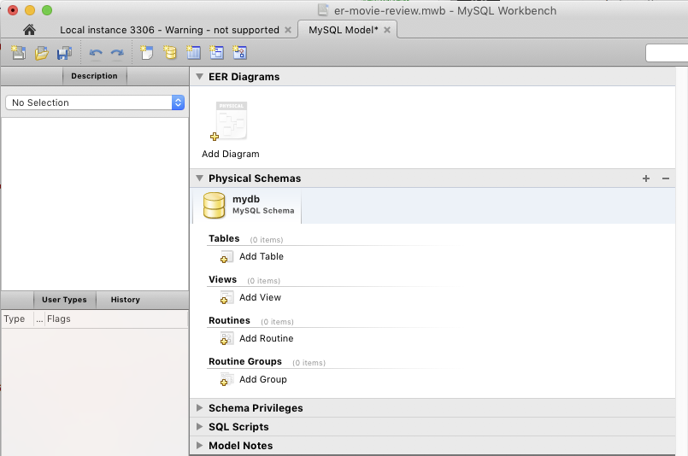
Creating a New Model
A window will appear as shown here.
Click on the “+” sign as highlighted to create a new schema.

Slide 15
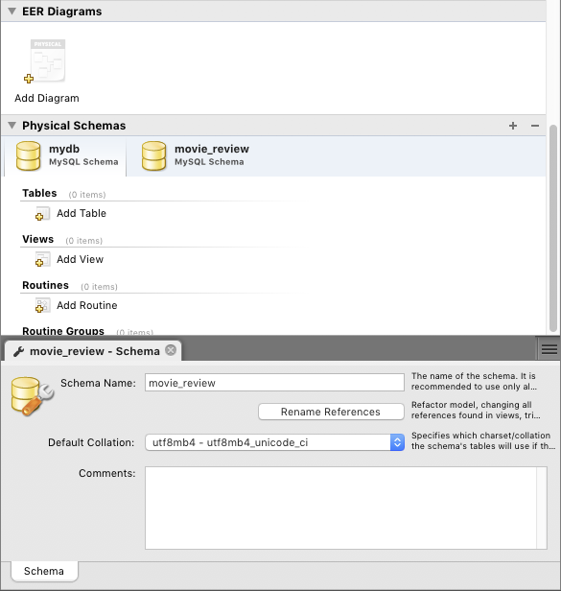
Creating a New Model
Enter the following information in the schema section:
For Schema Name, enter movie_review.
For Default Collation, select utf8mb4 – utf8mb4_unicode_ci.
Next, double click on the Add Diagram icon to add a new ER Model diagram to the movie_review schema.

Slide 16
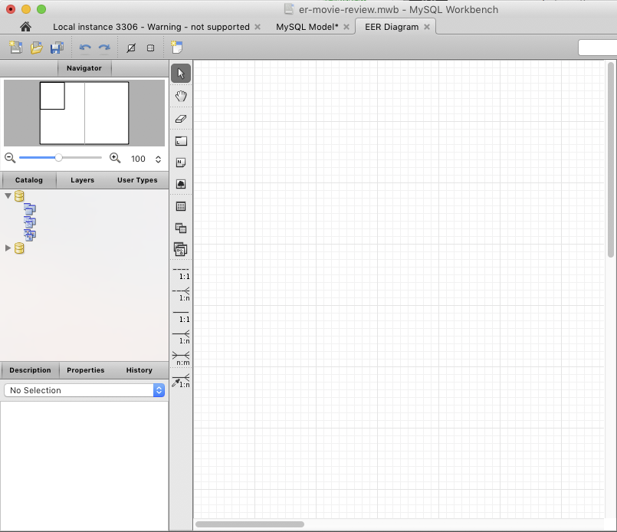
Creating a New Model
A new tab opens as shown here. This allows you to add tables into the grid area.
Click on this icon to create a new table then go to next slide.

Slide 17
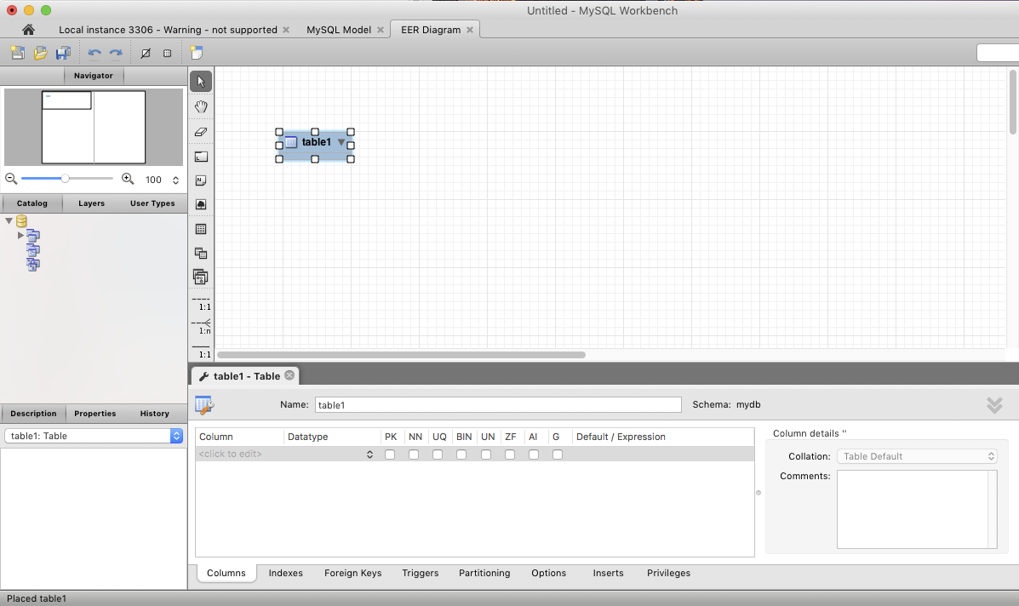
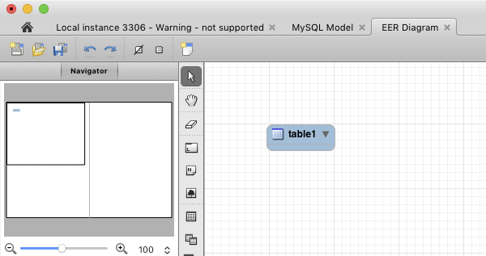
Creating a New Model
After the icon is clicked, an blue image of “table1” will appear as shown. Double click on it to bring out the bottom panel as shown on the right image.
Double click on this.

Slide 18
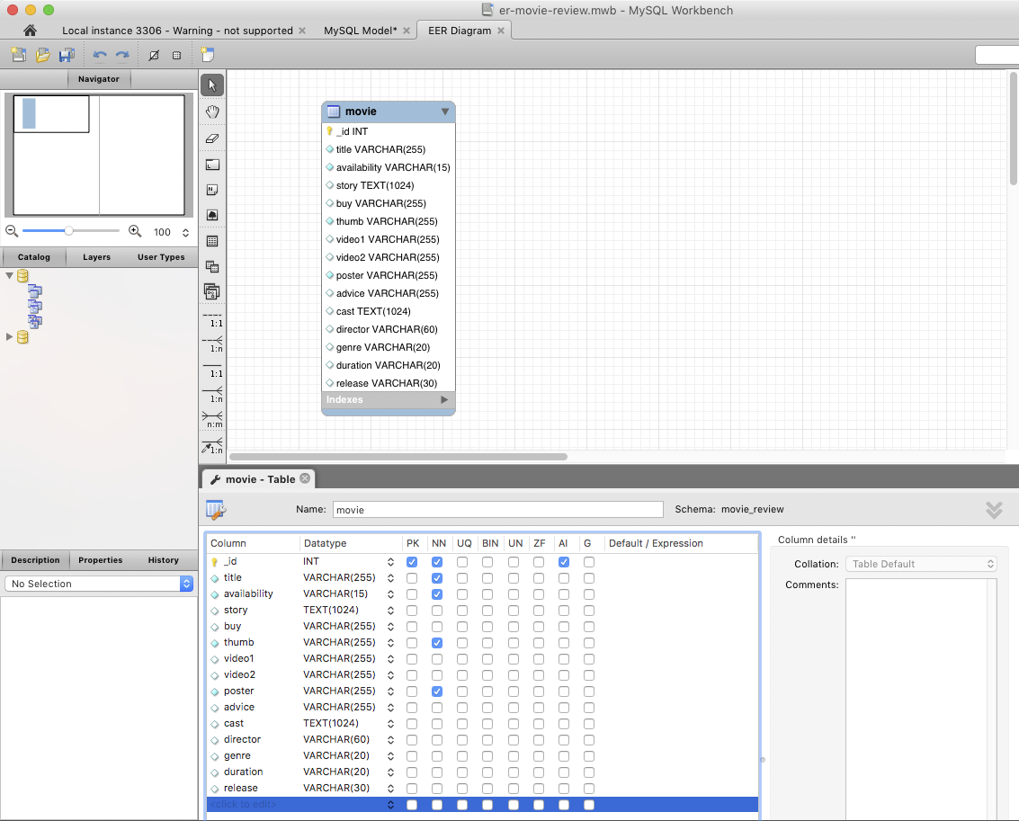
Creating a New Model
Follow the information in slide 11 for the movie table and create the fields in the bottom panel.
You should have the same view on the right after all fields are added.

Slide 19
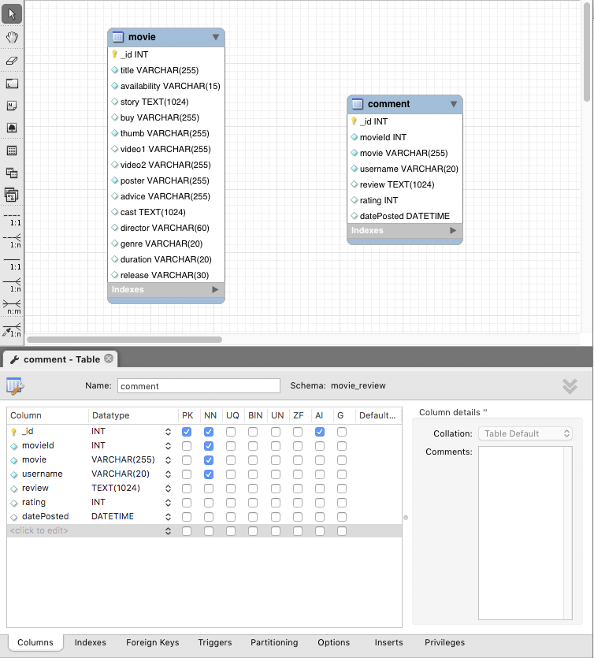
Creating a New Model
After you complete the movie table, use the same way to create the comment table.
You may ask how to set movieId as a Foreign Key? We will do that in the next slide after you’ve added all the fields. Just add movieId according to the diagram here as per normal.
You should have a similar view on the right after all fields are added.
Now click on the Foreign Keys tab at the bottom.

Slide 20
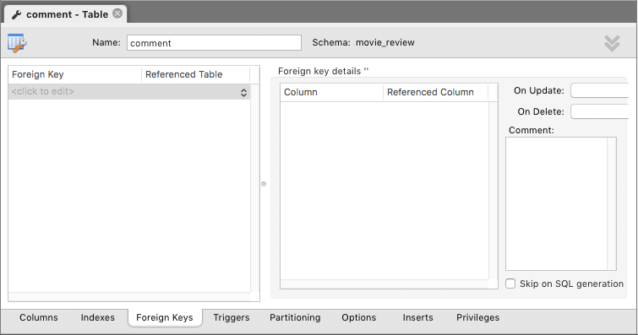
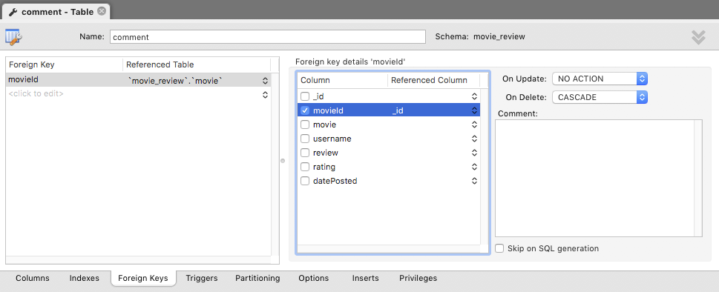
Creating a New Model
The Foreign Keys tab has 3 columns as shown here.
Starting with the left most column, enter “movieId” in the Foreign Key column.
In the Referenced Table column, select ‘movie_review’.’movie’ because this is where the Foreign Key should link to.
In the center column, check the movieId field and select _id as the Referenced Column because this is the Primary Key that movieId will link to.
In the right column, select CASCADE for On Delete. This ensures that if a particular movie is deleted, then all comments for this movie will be deleted automatically by the database server.

Slide 21
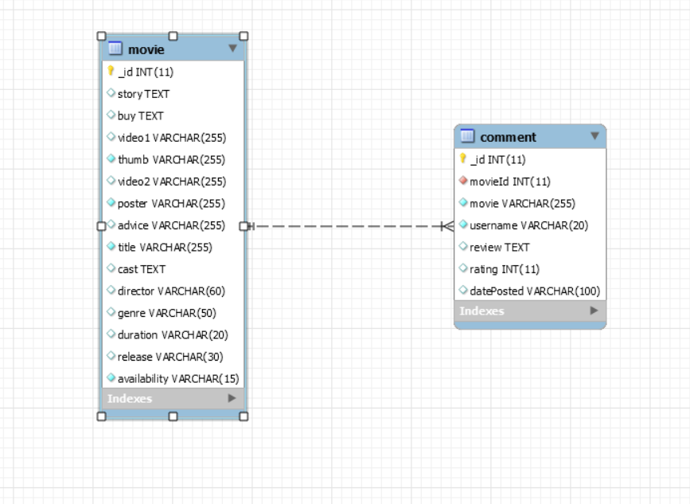
Creating a New Model
After the Foreign Key is defined, you will see a link automatically added as shown here.
So what exactly is a Foreign Key? Go to next slide to find out.

Slide 22
What is a Foreign Key?
A FOREIGN KEY is a key used to link two tables together.
A FOREIGN KEY is a field (or collection of fields) in one table that refers to the PRIMARY KEY in another table.
The table containing the foreign key is called the child table, and the table containing the candidate key is called the referenced or parent table.
The FOREIGN KEY constraint is used to prevent actions that would destroy links between tables.
The FOREIGN KEY constraint also prevents invalid data from being inserted into the foreign key column, because it has to be one of the values contained in the table it points to.

Slide 23
From Design to Physical Schema

Slide 24
Creating the Physical Schema from the Design
When you created a schema in the Model in slide 14, note that no physical schema was actually created in the database server.
The Model only provides a design view of the schema.
MySQL Workbench provides a way to transform the design to physical schema.
Start from the next slide to follow the process of how to do so.

Slide 25
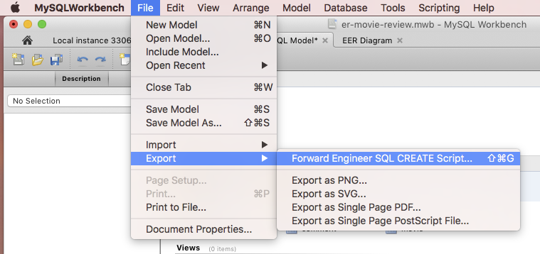
Transforming to Physical Schema
In the File menu, select Export and then Forward Engineering SQL CREATE Script… as shown here.

Slide 26
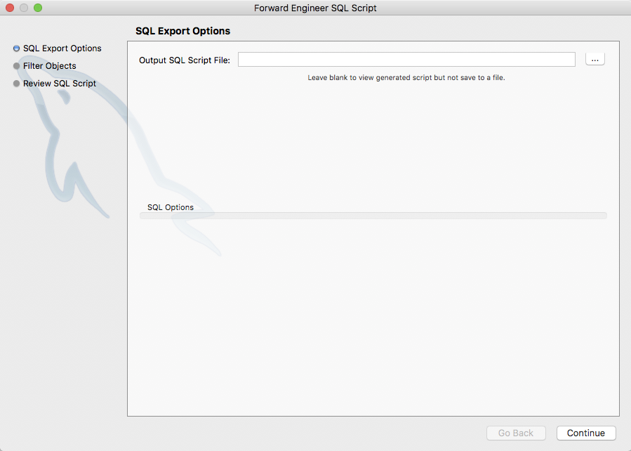
Transforming to Physical Schema
A window appears as shown below.
Click on this button to select a destination to save the auto-generated SQL script. You can name the file as er-movie-review.sql

Slide 27
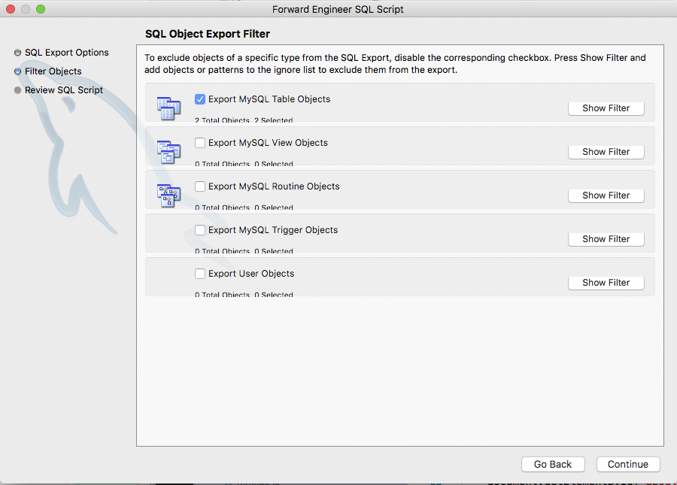
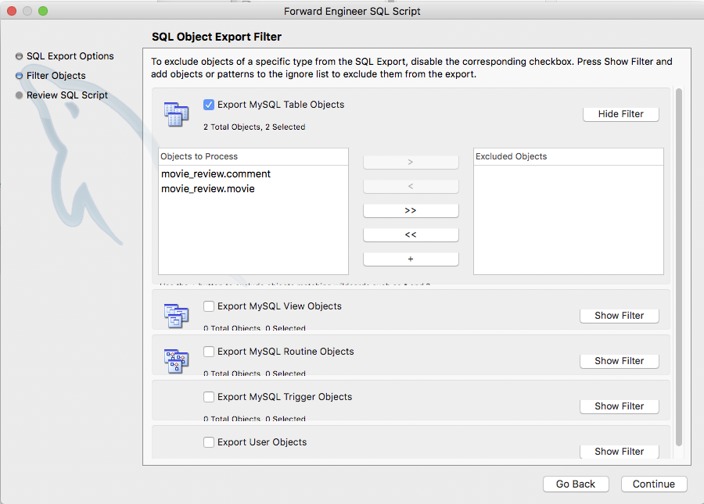
Transforming to Physical Schema
The window on the left appears.
Click on Show Filter button to check if the schema and tables are correct.
Click Continue button if they are correct.

Slide 28
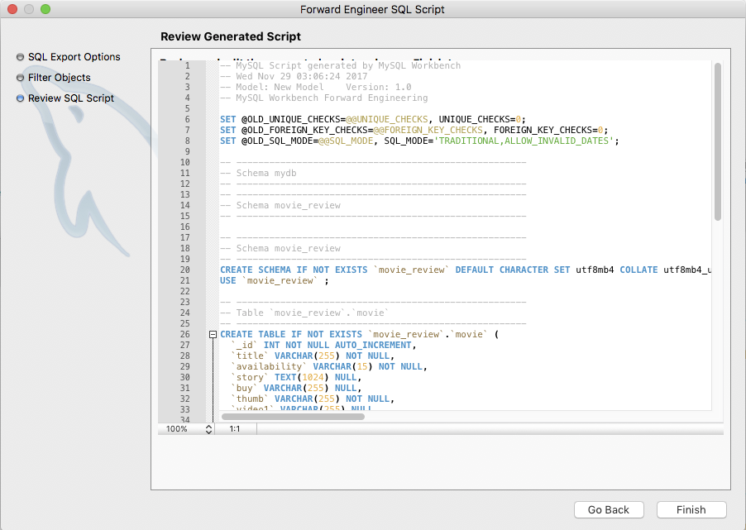
Transforming to Physical Schema
A new window appears that shows the whole SQL script for creating schema and tables.
Take a while to read the codes to understand how the SQL codes are written.
Click Finish button when you are done and the codes will be saved to the file.

Slide 29
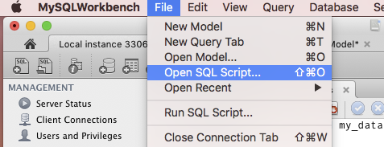
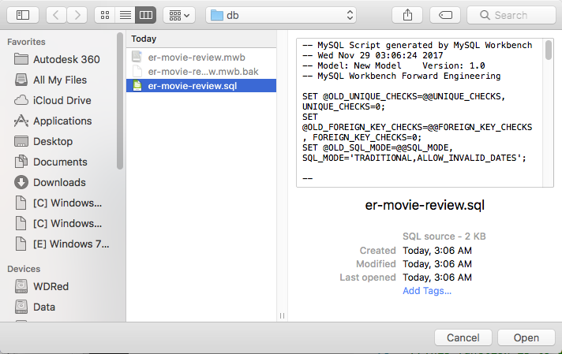
Transforming to Physical Schema
Next, go to File menu and select Open SQL Script….
Select the file that you saved, which is er-movie-review.sql.

Slide 30
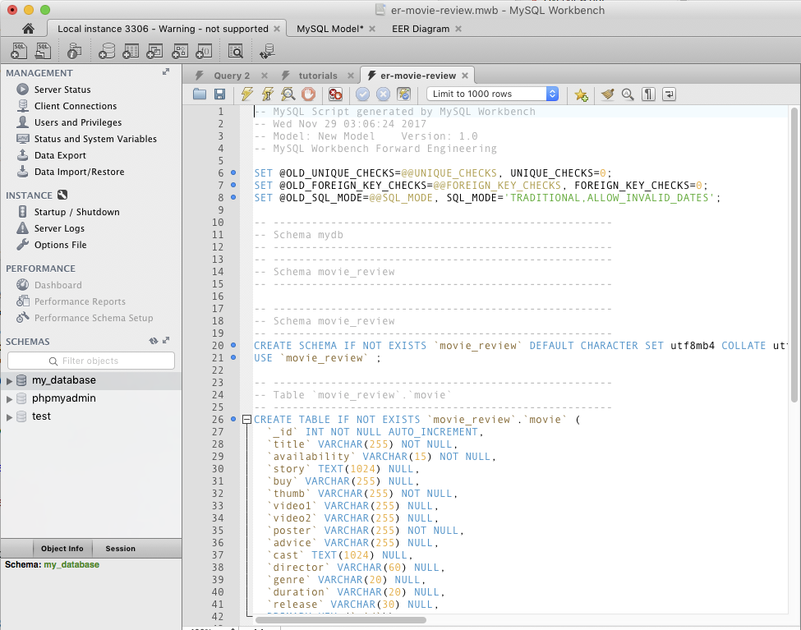
Transforming to Physical Schema
The SQL codes will be loaded as shown in a new tab.
Click on the lightning icon to execute the whole script.
Ensure there is no error in the Action Output pane at the bottom and go to next slide.

Slide 31
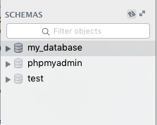
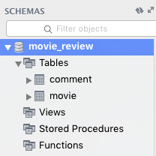
Transforming to Physical Schema
Click on the highlighted icon as shown to refresh the Schema list.
You should now see that the physical schema has been created.
Check the table columns to ensure that they are correct.

Slide 32
Next Episode
In the next episode, you will learn how to import data into the tables and write the codes in JavaScript to connect to the database.
If you have time now, do think about the design of the database for your project. Consult your lecturer about the tables and fields that are suitable for your website.

Slide 33
Reference
TutorialsPoint – Learn MySQL
https://www.tutorialspoint.com/mysql/index.htm
W3Schools – SQL Foreign Key Constraint
https://www.w3schools.com/sql/sql_foreignkey.asp

Slide 34
The End

